Slide 1

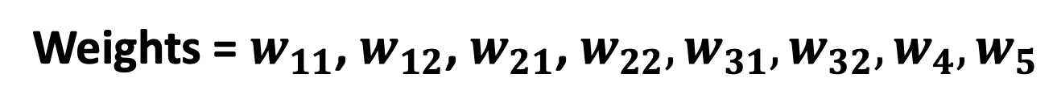







$$w_{11}$$
$$w_{4}$$
$$w_{12}$$
$$w_{21}$$
$$w_{22}$$
$$w_{5}$$
$$w_{31}$$
$$w_{32}$$
Weights = $w_{11}$, $w_{12}$, $w_{21}$, $w_{22},w_{31},w_{32},w_{4},w_{5}$

Slide 2

























$$I_{1}$$
$$w_{11}$$
$$h_{1}$$
$$O_{1}$$
$$w_{11}$$
$$I_{1}$$
$$w_{21}$$
$$I_{2}$$
$$w_{4}$$
$$w_{12}$$
$$I_{2}$$
$$a_{1}$$
$$w_{21}$$
$$h_{2}$$
$$O_{2}$$
$$w_{22}$$
$$w_{5}$$
$$w_{4}$$
$$h_{1}$$
$$w_{31}$$
$$I_{3}$$
$$y$$
$$O_{1}$$
$$O_{2}$$
$$w_{32}$$
$$C_{0}$$

Slide 3





































$$I_{1}$$
$$w_{11}$$
$$I_{1}$$
$$w_{21}$$
$$I_{2}$$
$$w_{31}$$
$$I_{3}$$
$$w_{12}$$
$$I_{1}$$
$$w_{22}$$
$$I_{2}$$
$$w_{32}$$
$$I_{3}$$
$$w_{11}$$
$$h_{1}$$
$$O_{1}$$
$$w_{4}$$
$$w_{12}$$
$$I_{2}$$
$$w_{21}$$
$$a_{1}$$
$$a_{2}$$
$$h_{2}$$
$$O_{2}$$
$$w_{22}$$
$$w_{5}$$
$$w_{31}$$
$$h_{1}$$
$$w_{4}$$
$$w_{5}$$
$$h_{2}$$
$$I_{3}$$
$$w_{32}$$
$$y$$
$$O_{1}$$
$$O_{2}$$
$$C_{0}$$

Slide 4
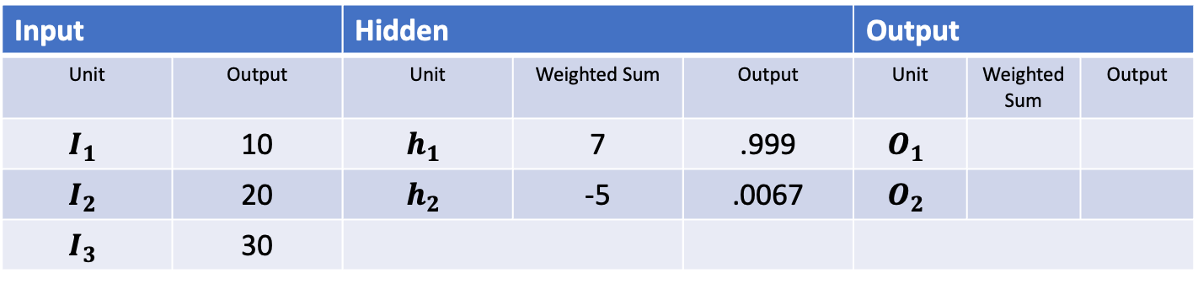
Input |  | Hidden |  |  | Output
Unit | Output | Unit | Weighted Sum | Output | Unit | Weighted Sum | Output
$$I_{1}$$ | 10 | $$h_{1}$$ | 7 | .999 | $$O_{1}$$
$$I_{2}$$ | 20 | $$h_{2}$$ | -5 | .0067 | $$O_{2}$$
$$I_{3}$$ | 30
$$I_{1}$$
$$w_{11}$$
$$I_{1}$$
$$w_{21}$$
$$I_{2}$$
$$w_{31}$$
$$I_{3}$$
$$w_{12}$$
$$I_{1}$$
$$w_{22}$$
$$I_{2}$$
$$w_{32}$$
$$I_{3}$$
$$w_{11}$$
$$h_{1}$$
$$O_{1}$$
$$w_{4}$$
$$w_{12}$$
$$I_{2}$$
$$w_{21}$$
$$a_{1}$$
$$a_{2}$$
$$h_{2}$$
$$O_{2}$$
$$w_{22}$$
$$w_{5}$$
$$w_{31}$$
$$h_{1}$$
$$w_{4}$$
$$w_{5}$$
$$h_{2}$$
$$I_{3}$$
$$w_{32}$$
$$y$$
$$O_{1}$$
$$O_{2}$$
$$h_{1} = (0.2 ∗ 10) + (−0.1 ∗ 30) + (0.4 ∗ 20) = 2 −3 + 8 = 7$$
$$C_{0}$$

Slide 5



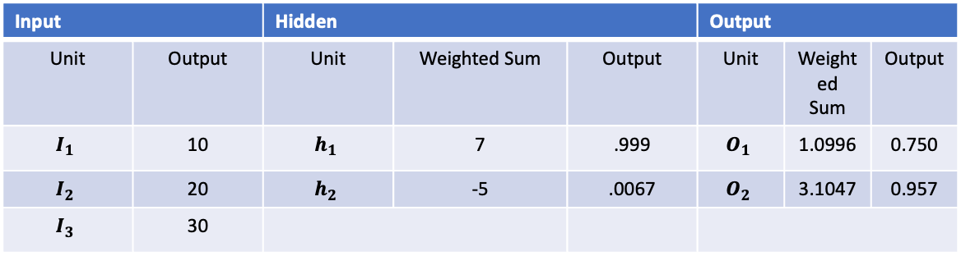



















$$w_{11}$$
$$I_{1}$$
$$w_{21}$$
$$I_{2}$$
$$w_{31}$$
$$I_{3}$$
$$w_{12}$$
$$I_{1}$$
$$w_{22}$$
$$I_{2}$$
$$w_{32}$$
$$I_{3}$$
Input |  | Hidden |  |  | Output
Unit | Output | Unit | Weighted Sum | Output | Unit | Weighted Sum | Output
$$I_{1}$$ | 10 | $$h_{1}$$ | 7 | .999 | $$O_{1}$$ | 1.0996 | 0.750
$$I_{2}$$ | 20 | $$h_{2}$$ | -5 | .0067 | $$O_{2}$$ | 3.1047 | 0.957
$$I_{3}$$ | 30
$$a_{1}$$
$$a_{2}$$
$$h_{1}$$
$$w_{4}$$
$$w_{5}$$
$$h_{2}$$
$$y$$
$$O_{1}$$
$$O_{2}$$
$$a_{1} = (0.2 ∗ 10) + (−0.1 ∗ 30) + (0.4 ∗ 20) = 2 −3 + 8 = 7$$
$$C_{0}$$
$$h_{1}\text{ = }\frac{1}{1+\text{e}\text{−7}} \text{1/(1+}\text{e}\text{-7}\text{) = 1/(1+0.000912) = 0.999}$$

Slide 6













Forward Pass
Desired output (y)
$$w_{3}$$
$$a_{2}$$
$$w_{1}$$
$$b_{3}$$
$$w_{2}$$
$$w_{3}$$
1.00
$$z_{3}$$
$$z_{3}=w_{3}a_{2}+b_{3}$$
$$y$$
$$a_{3}$$
$$a_{3}=σ(z_{3})$$
$$C_{0}$$
$$C_{0} ={\left(a_{3} −y\right)}^{2}$$

Slide 7

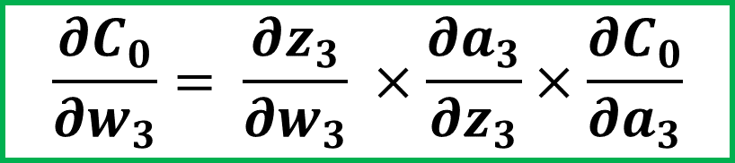


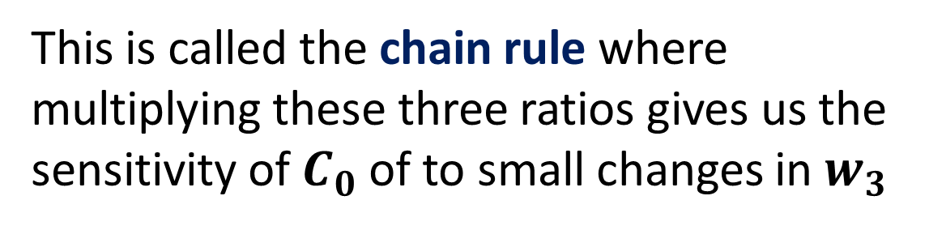




Chain Rule
$$w_{3}$$
$$a_{2}$$
$$b_{3}$$
Our first goal is to understand how sensitive the cost function is to small changes in our weight
$$z_{3}$$
$$\frac{∂C_{0}}{∂w_{3}}= \frac{∂z_{3}}{∂w_{3}} ×\frac{∂a_{3}}{∂z_{3}}×\frac{∂C_{0}}{∂a_{3}}$$
$$y$$
$$a_{3}$$
This is called the chain rule where multiplying these three ratios gives us the sensitivity of $C_{0}$of to small changes in $w_{3}$
$$C_{0}$$
Notes:
The derivative is a tool of calculus that quantifies the sensitivity of change of a functions output with respect to its input

Slide 8
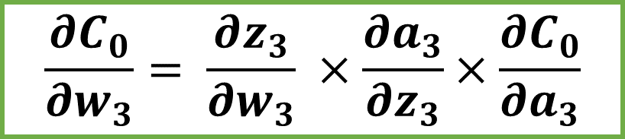
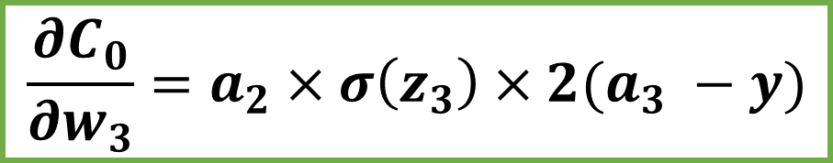
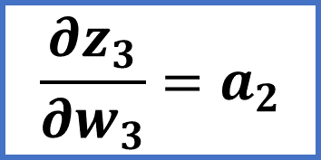
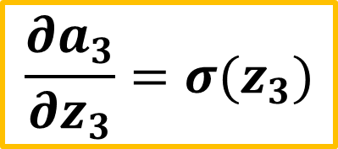
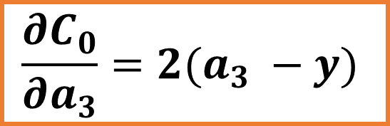
Chain Rule
$$\frac{∂C_{0}}{∂w_{3}}= \frac{∂z_{3}}{∂w_{3}} ×\frac{∂a_{3}}{∂z_{3}}×\frac{∂C_{0}}{∂a_{3}}$$
$$\frac{∂C_{0}}{∂a_{3}}=2(a_{3} −y)$$
$$\frac{∂a_{3}}{∂z_{3}}=σ(z_{3})$$
$$\frac{∂z_{3}}{∂w_{3}}=a_{2}$$
$$\frac{∂C_{0}}{∂w_{3}}=a_{2}×σ\left(z_{3}\right)×2(a_{3} −y)$$

Slide 9


Chain Rule
$$\frac{∂C_{0}}{∂w_{3}}=a_{2}×σ\left(z_{3}\right)×2(a_{3} −y)$$
This is only for one training example!
$$\frac{∂C}{∂w_{i}}= \frac{1}{n} \sum_{k=0}^{n −1}{\frac{∂C_{k}}{∂w_{i}}}$$
We need to average of all training examples

Slide 10
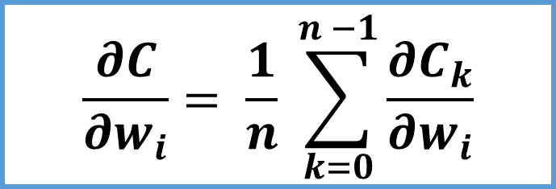
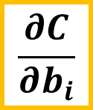

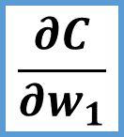
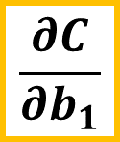
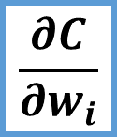
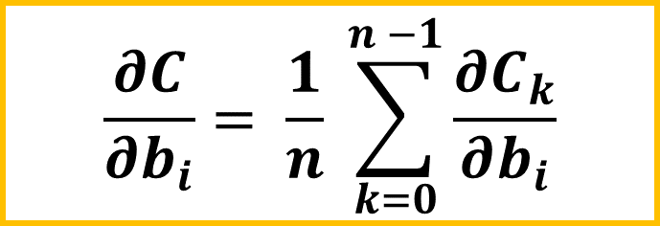
Gradient
$$\frac{∂C}{∂w_{1}}$$
$$\frac{∂C}{∂w_{i}}= \frac{1}{n} \sum_{k=0}^{n −1}{\frac{∂C_{k}}{∂w_{i}}}$$
$$\frac{∂C}{∂b_{1}}$$
$$∇C=$$
.
.
.
$$\frac{∂C}{∂b_{i}}= \frac{1}{n} \sum_{k=0}^{n −1}{\frac{∂C_{k}}{∂b_{i}}}$$
$$\frac{∂C}{∂w_{i}}$$
$$\frac{∂C}{∂b_{i}}$$
Notes:
The gradient gives the direction and the rate of of fastest increase

Slide 11
















Iterating the Chain rule
$$w_{2}$$
$$a_{1}$$
$$b_{2}$$
$$z_{2}$$
y
$$w_{2}$$
$$w_{3}$$
1.00
$$w_{3}$$
$$a_{2}$$
$$b_{3}$$
$$a_{1}$$
$$a_{2}$$
$$a_{3}$$
$$z_{3}$$
$$y$$
$$a_{3}$$
$$C_{0}$$

Slide 12
Back Propagation Example

Slide 13

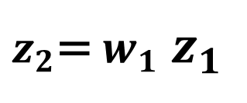


$$z_{1}$$
$$z_{2}$$
$$w_{1}$$
$z_{2}$= $w_{1}$ $z_{1}$

Slide 14

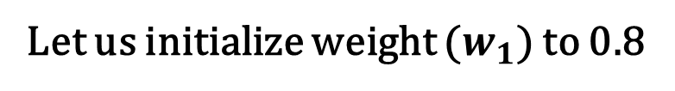
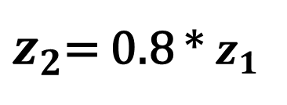

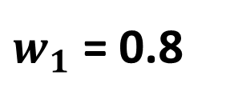
$$z_{1}$$
Let us initialize weight ($w_{1}$) to 0.8
$$z_{2}$$
$w_{1}$ = 0.8
$z_{2}$= 0.8 * $z_{1}$

Slide 15
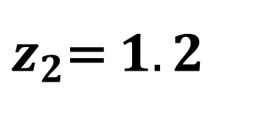

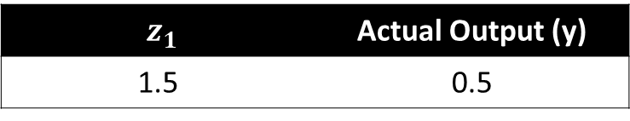
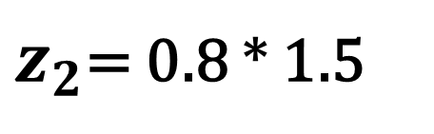

$z_{1}$ | Actual Output (y)
1.5 | 0.5
$$z_{1}$$
$$z_{2}$$
$w_{1}$ = 0.8
$z_{2}$= 0.8 * 1.5
$z_{2}$= $1.2$

Slide 16
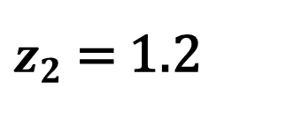

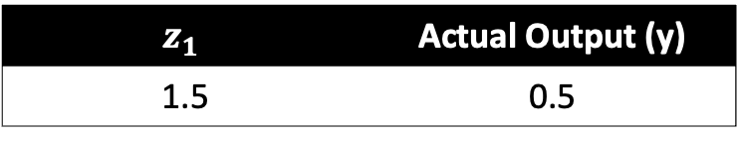
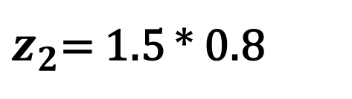

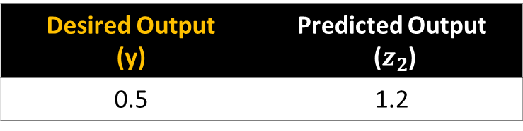
$$z_{1}$$ | Actual Output (y)
1.5 | 0.5
$$z_{1}$$
$$z_{2}$$
$w_{1}$ = 0.8
$z_{2}$= 1.5 * 0.8
$z_{2}$= 1.2
Desired Output (y) | Predicted Output ($z_{2}$)
0.5 | 1.2

Slide 17
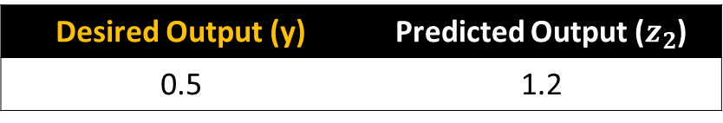

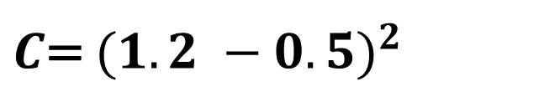
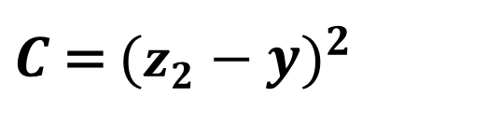
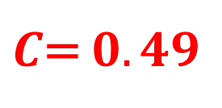
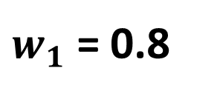
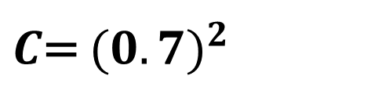
Let us use Mean Squared Error (MSE) as our cost function
Desired Output (y) | Predicted Output ($z_{2}$)
0.5 | 1.2
$$z_{1}$$
$$z_{2}$$
$w_{1}$ = 0.8
$C$ = ${(z_{2}−y)}^{2}$
$C$= ${(1.2 −0.5)}^{2}$
$C$= ${(0.7)}^{2}$
$C$= $0.49$

Slide 18
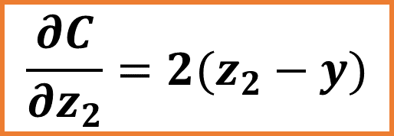
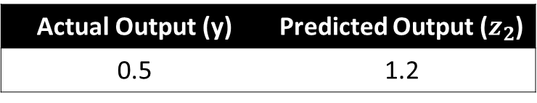
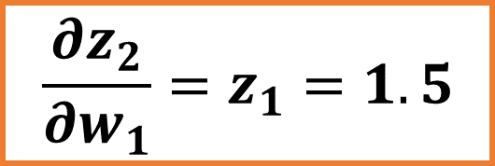
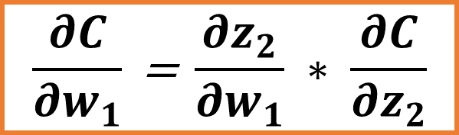
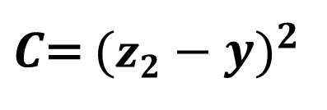
Actual Output (y) | Predicted Output ($z_{2}$)
0.5 | 1.2
$C$= ${(z_{2}−y)}^{2}$
Actual Output (y)
$$\frac{∂C}{∂w_{1}}\text{ = }\frac{∂z_{2}}{∂w_{1}} ∗ \frac{∂C}{∂z_{2}}$$
$$\frac{∂z_{2}}{∂w_{1}}=z_{1}=1.5$$
Weight
$$\frac{∂C}{∂z_{2}}=2(z_{2}−y)$$

Slide 19
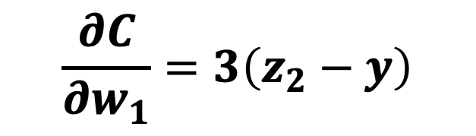
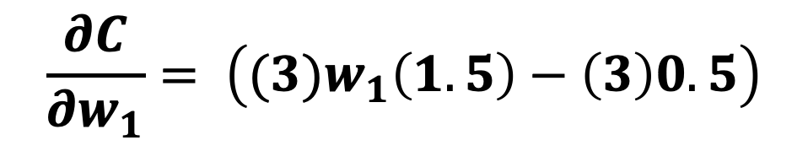
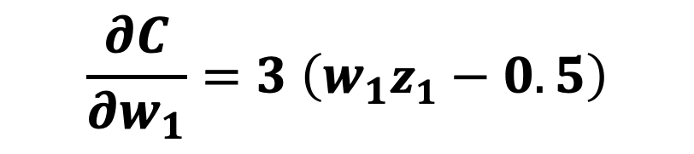
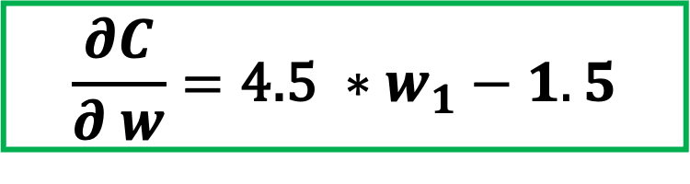
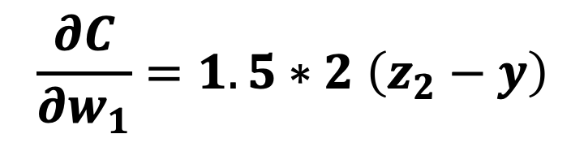
$$\frac{∂C}{∂w_{1}}=1.5∗2 \left(z_{2}−y\right)$$
$$\frac{∂C}{∂w_{1}}=3\left(z_{2}−y\right)$$
Actual Output (y)
$$\frac{∂C}{∂w_{1}}=3 \left(w_{1}z_{1}−0.5\right)$$
$$\frac{∂C}{∂w_{1}}= \left({(3)w}_{1}\left(1.5\right)−\left(3\right)0.5\right)$$
Weight
$$\frac{∂C}{∂ w}=\text{4.5 }∗w_{1}−1.5$$

Slide 20
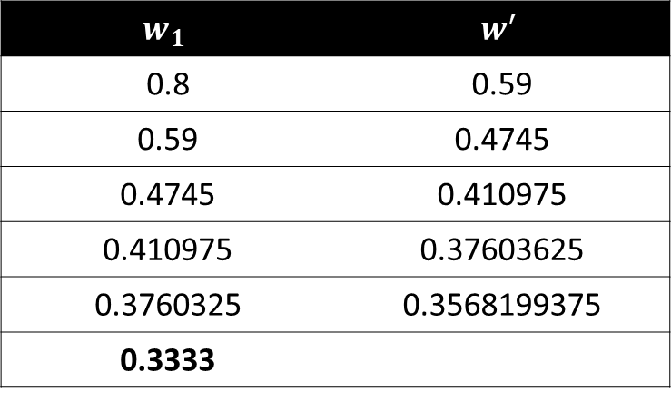
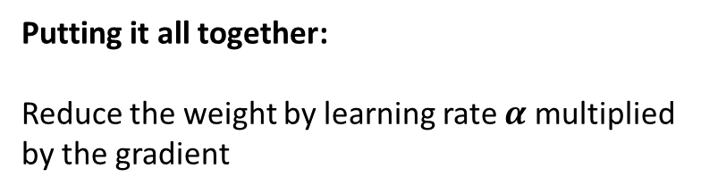
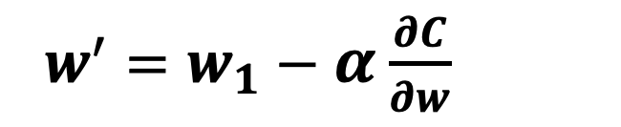
Putting it all together:
Reduce the weight by learning rate $α$ multiplied by the gradient
$w^{′}=w_{1}−α$ $\frac{∂C}{∂w}$
Actual Output (y)
$$w^{′}=w_{1}−0.1∗(4.5w_{1}−1.5)$$
$$w_{1}$$ | $$w^{′}$$
0.8 | 0.59
0.59 | 0.4745
0.4745 | 0.410975
0.410975 | 0.37603625
0.3760325 | 0.3568199375
0.3333
Weight

